Slide 1

Improving Development for United States Donors for Hire Heroes USA
Abie Kanu, Mohammed Al-khori, Meredith Lee and Lucia Traweek
Virginia Commonwealth University

Slide 2

Background
501c3 nonprofit organization
Veteran and military spouse employment
Services are free, virtual, personal
virtual workshops, career fairs, webinars, a job board and more.
Partner with companies that offer scholarships and training opportunities to veterans and military spouses.
Use Volunteers and Donations to run non-profit

Slide 3
Problem Statement
Geographic Location for Individual Donors
Average Lifespan of Monthly Donor
Unsolicited Donors

Slide 4
Cleaning Data
Tableau
Combined the SalesForce_Contact database, SalesForce_Opportunity and SaleForce_Account database based on AccountID field
Downloaded it as an Excel file.
Excel
Entries in the SalesForce_Contact database not donors removed
Unnecessary columns deleted
Geographic locations (State and ZipCode)

Slide 5

Geographical Location- Individual Donors
Donations concentrated around cities
East Coast
Northwest
Texas
Most donors from a state is Georgia 1777
Most donors zip code Hartland, Wisconsin 397 donors

Slide 6
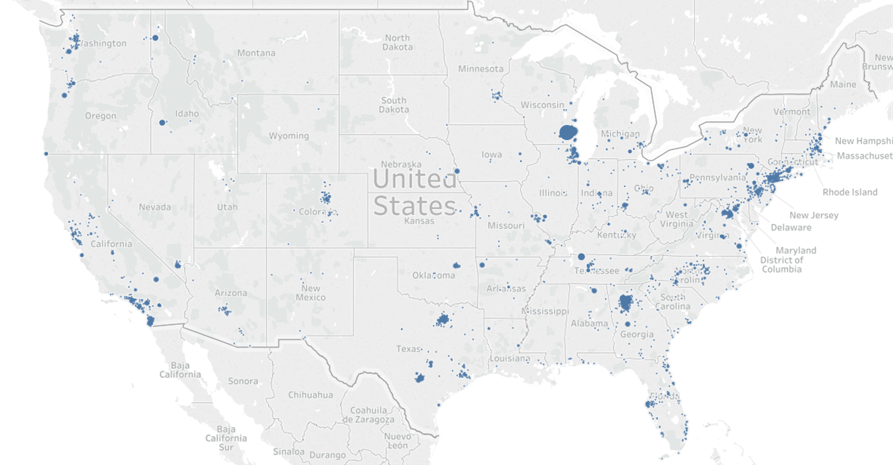
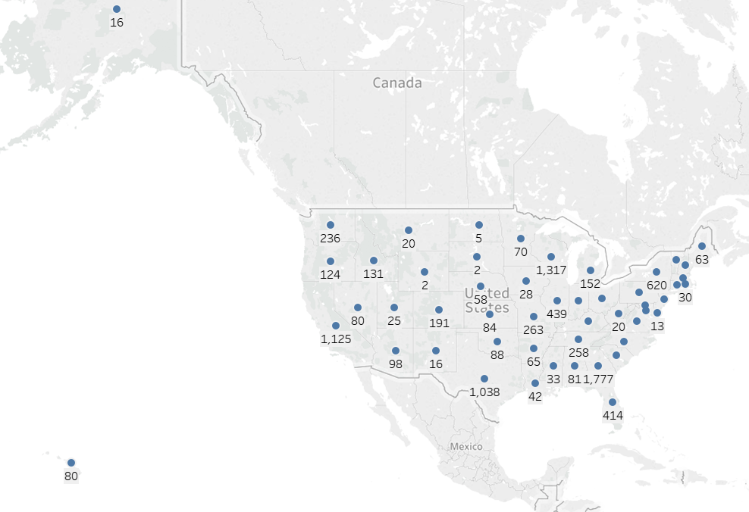
Figure 1. Heap Map of United States where Individual Donors are counted by zipcode
Figure 2. Heat Map by State of count of Individual Donors

Slide 7
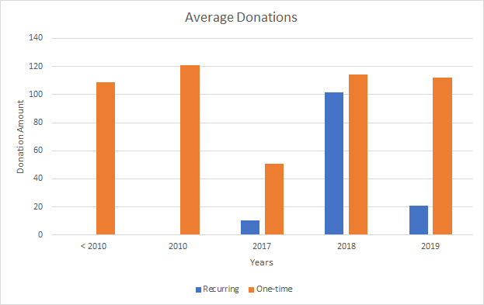
Recurring Donors v. One-time Donors
Average Lifespan of donor: 2.4 months
Lapse of time where they give less or more
One-time donors: larger donation amounts

Slide 8
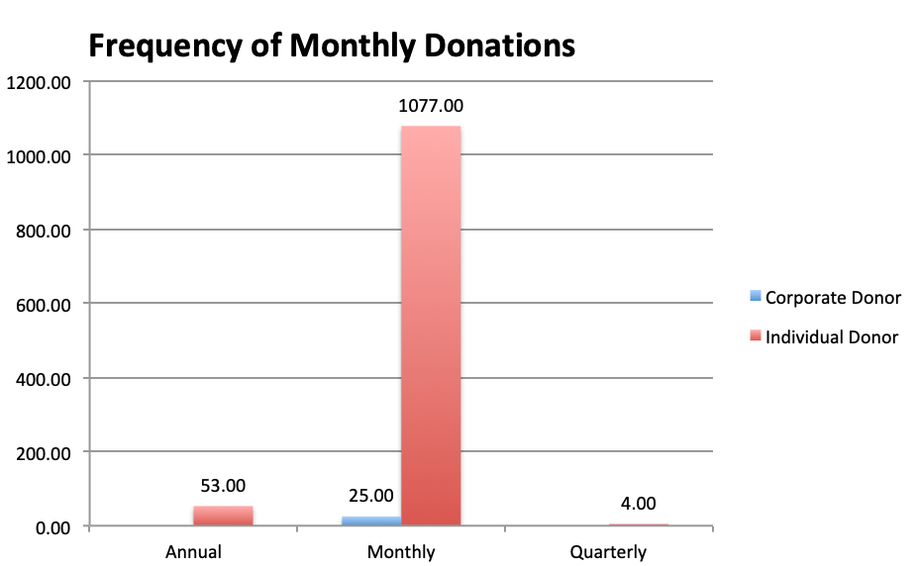
Frequency of Unsolicited Donors
There were 1,102 total monthly
donations from the two groups.
625 of these individual and
corporate donors are recurring.
Average gift amount from
unsolicited donors came out to: $188.
Monthly giving,
through tailored advertisements and emails, etc.

Slide 9
Conclusion
Gained insights on the donor data which could lead to more donations
Invest in high-quality data mining resources to maximize the number of donations received to increase the potential they have to help people

